Slide 1
SESS
Faculty
Departments
Faculty Edu
Progs
Entries
Terms
Department Manager
Term Progs
Course
Staff
Tech
Room
+Timing
Courses
Templates
Template Data
Staff
Tech
Classes
Rooms
Labs

Slide 2
Faculty
Departments
Progs
Entries
Terms
Department Manager
Course List
Templates
Term Progs
Course
Staff
Tech
Room
+Timing
Template Data
Staff
Tech
Classes
Rooms
Labs
Departments
ID (Long)
DepartmentName (String *40)
Notes (String * 10)
DepartmentPass (String * 20)
Acc1 - Acc5 As Boolean

Slide 3
Faculty
Departments
Progs
Entries
Terms
Department Manager
Course List
Templates
Term Progs
Course
Staff
Tech
Room
+Timing
Template Data
Staff
Tech
Classes
Rooms
Labs
Technecians
ID (Long)
StaffName (String * 50)
Department (Long)
Invited (Y/N)
TechCode (Long)

Slide 4
Faculty
Departments
Progs
Entries
Terms
Department Manager
Course List
Templates
Term Progs
Course
Staff
Tech
Room
+Timing
Template Data
Staff
Tech
Classes
Rooms
Labs
Rooms
ID (Long)
RoomName (String * 100)
RoomCapacity (Long)
VideoProjector (Y/N)
Notes (String * 255)

Slide 5
Faculty
Departments
Progs
Entries
Terms
Department Manager
Course List
Templates
Term Progs
Course
Staff
Tech
Room
+Timing
Template Data
Staff
Tech
Classes
Rooms
Labs
BioProgs
ID (Long)
ProgramName (String * 50)
Levelx (String * 20)
ServicePrograms (Y/N)
StaffPrograms (Y/N)
Department_ID (Long)
Notes (String * 255)

Slide 6
Faculty
Departments
Progs
Entries
Terms
Department Manager
Course List
Templates
Term Progs
Course
Staff
Tech
Room
+Timing
Template Data
Staff
Tech
Classes
Rooms
Labs
Staff
ID (Long)
StaffName (String * 100)
StaffCode (Long)
Affiliation (Long)
Notes (String * 255)

Slide 7
Faculty
Departments
Progs
Entries
Terms
Department Manager
Course List
Templates
Term Progs
Course
Staff
Tech
Room
+Timing
Template Data
Staff
Tech
Classes
Rooms
Labs
Entries
ID (Long)
BioProg_ID (Long)
EntYear (Integer)
StudentCount (Long)
Active (Y/N)
Note (String * 255)

Slide 8
Faculty
Departments
Progs
Entries
Terms
Department Manager
Course List
Templates
Term Progs
Course
Staff
Tech
Room
+Timing
Template Data
Staff
Tech
Classes
Rooms
Labs
Courses
ID (Long)
BioProg_ID (Long)
CourseName (String * 255)
CourseNumber (Double)
Units (Int)
Units_equivalent (Single)

Slide 9
Faculty
Departments
Progs
Entries
Terms
Department Manager
Course List
Templates
Term Progs
Course
Staff
Tech
Room
+Timing
Template Data
Staff
Tech
Classes
Rooms
Labs
Terms
ID (Long)
Term (String * 10)
Manager (Long)
Notes (String * 255)
Active (Y/N)

Slide 10
Faculty
Departments
Progs
Entries
Terms
Department Manager
Course List
Templates
Term Progs
Course
Staff
Tech
Room
+Timing
Template Data
Staff
Tech
Classes
Rooms
Labs
Templates
ID (Long)
TemplateName (String * 50)
nTerms (Integer)
BioProg_ID (Long)
Notes (String * 255)

Slide 11
Faculty
Departments
Progs
Entries
Terms
Department Manager
Course List
Templates
Term Progs
Course
Staff
Tech
Room
+Timing
Template Data
Staff
Tech
Classes
Rooms
Labs
TemplateData
ID (Long)
Template_ID (Long)
Course_ID (Long)
Term (long)

Slide 12
Faculty
TermProgs
ID (Long)
Entry_ID (Long)
Term_ID (Long)
Course_ID (Long)
Staff_ID (Long)
Tech_ID (Long)
Group (Integer)
SAT (String * 6)
SUN (String * 6)
MON (String * 6)
TUE (String * 6)
WED (String * 6)
THR (String * 6)
RoomID (Long)
SAT (String * 6)
SUN (String * 6)
MON (String * 6)
TUE (String * 6)
WED (String * 6)
THR (String * 6)
RoomID2 (Long)
Capacity (Integer)
ExamDate (String * 18)
Notes (Sring * 255)
Merged (Y/N)
Departments
Progs
Entries
Terms
Department Manager
Course List
Templates
Term Progs
Course
Staff
Tech
Room
+Timing
Template Data
Staff
Tech
Classes
Rooms
Labs

Slide 13
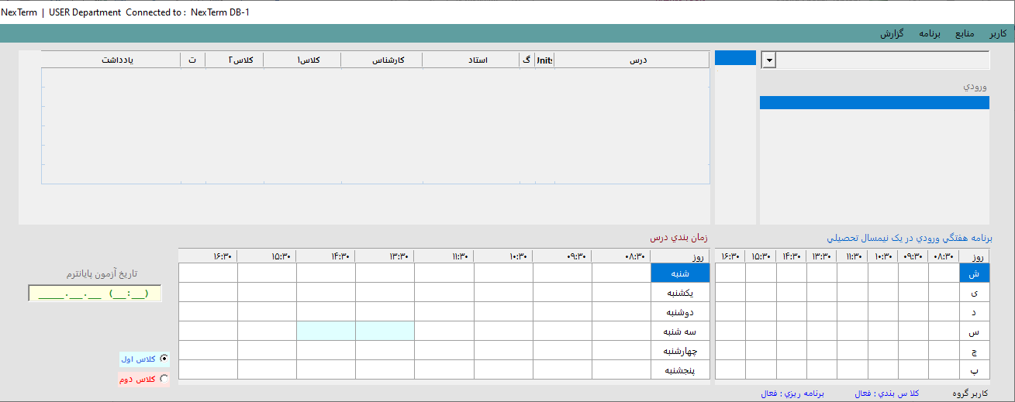
1
2
5
4
3
9
7
6
8

